Slide 1
Carbohydrate Metabolism:
Mono/disaccharide Metabolism
INTER 111: Graduate Biochemistry

Slide 2
Monosaccharide &
Disaccharide Metabolism
Glycogen
R5P
Glucose
Disaccharides
fructose
galactose
NADH + H⁺
and
ATP
Pyruvate
aerobic
conditions
O₂
H₂O
NADH + H⁺
and FADH₂
and CO₂
Electron transport
Oxidative phosphorylation
Acetyl CoA
citric
acid
cycle
ADP + P_{i}
ATP

Slide 3
Artificial sweeteners
Sugar substitute: food additive to duplicate sugar taste but with less food energy
Sweetness of compounds many fold greater than glucose or sucrose
Ongoing controversy over health risks

Slide 4
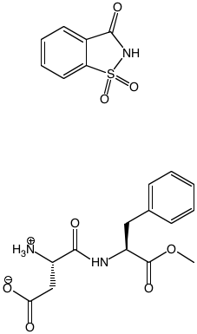
Artificial sweeteners
Saccharin
  discovered in 1879
  300X sweeter than sucrose
  no food energy
Aspartame
  Discovered in 1965
  180X sweeter than sucrose
saccharin
aspartame

Slide 5
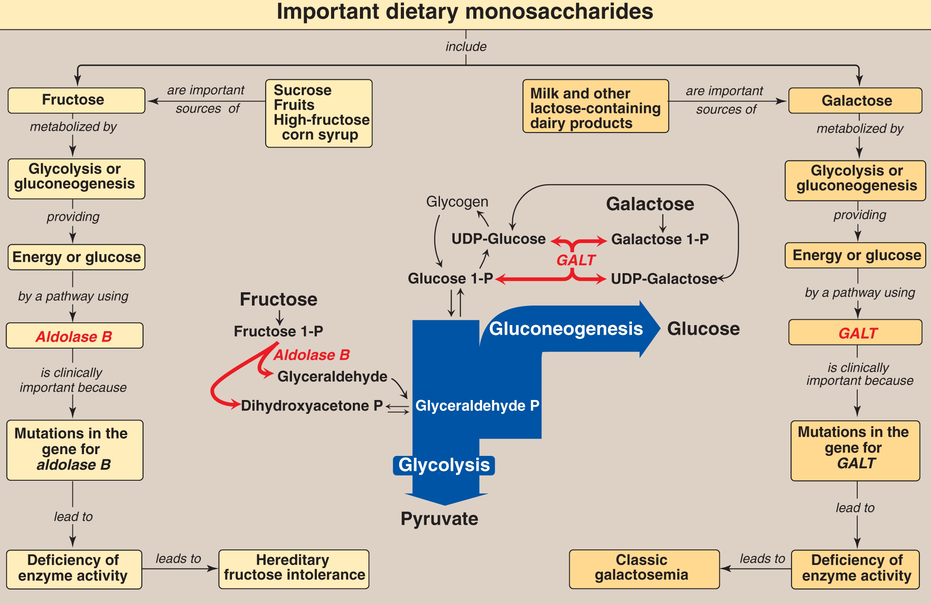

Slide 6
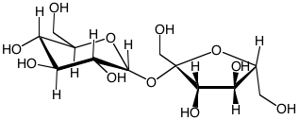
Fructose metabolism
SUCROSE
Typical Western diet contains 50 g fructose/day
Fructose found in corn syrup, fruits, and honey
Insulin-independent

Slide 7
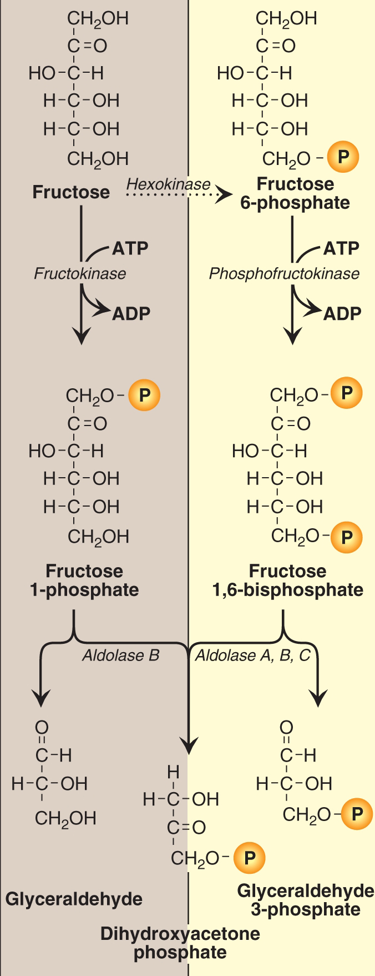
Phosphorylated products of fructose and their cleavage
Glycolysis
Fructose metabolism
Either hexokinase or fructokinase can covalently modify fructose.
Hexokinase phosphorylates glucose rather than fructose, unless [fructose] is unusually high.
Fructokinase found in particular tissues

Slide 8
Phosphorylated products of fructose
Glycolysis
Fructose metabolism

Slide 9
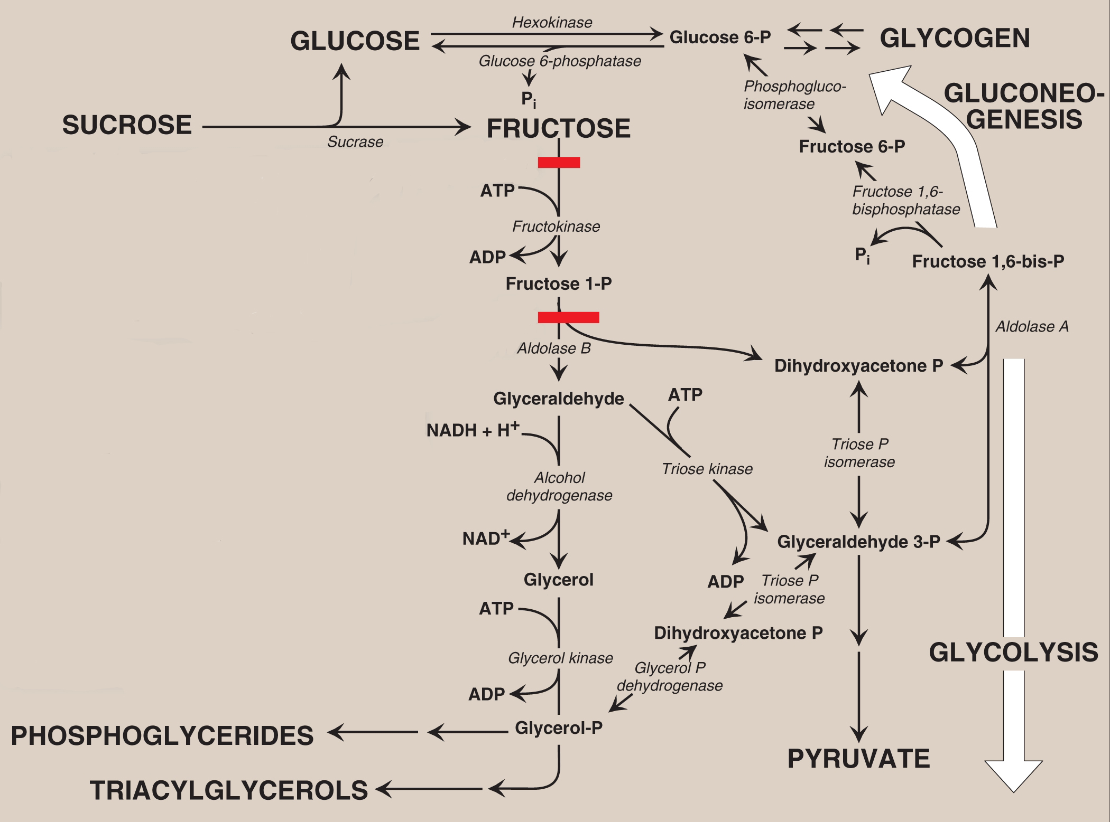

Slide 10
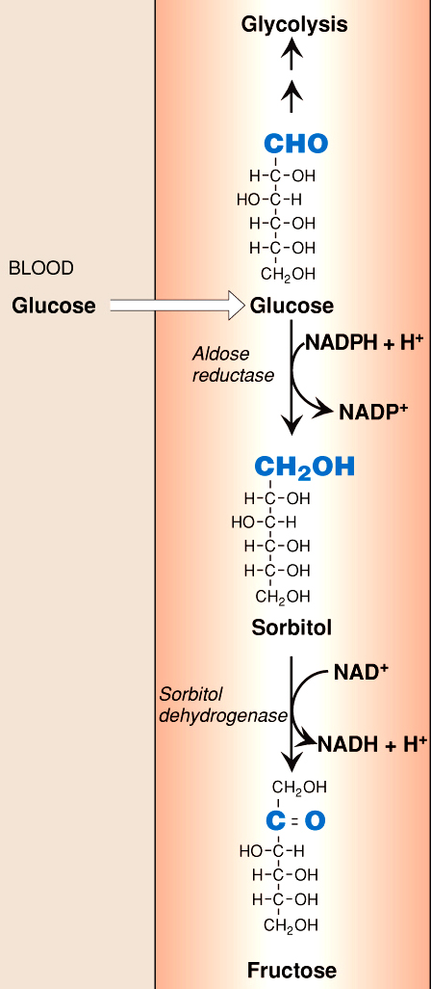
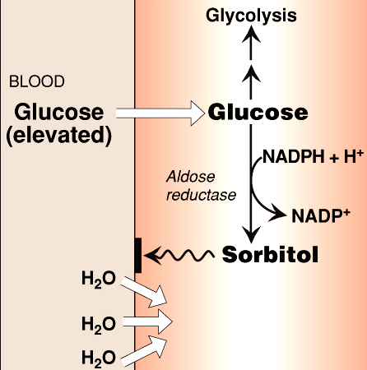
Sorbital metabolism
Lens, kidney, nerve
Seminal vesicles

Slide 11
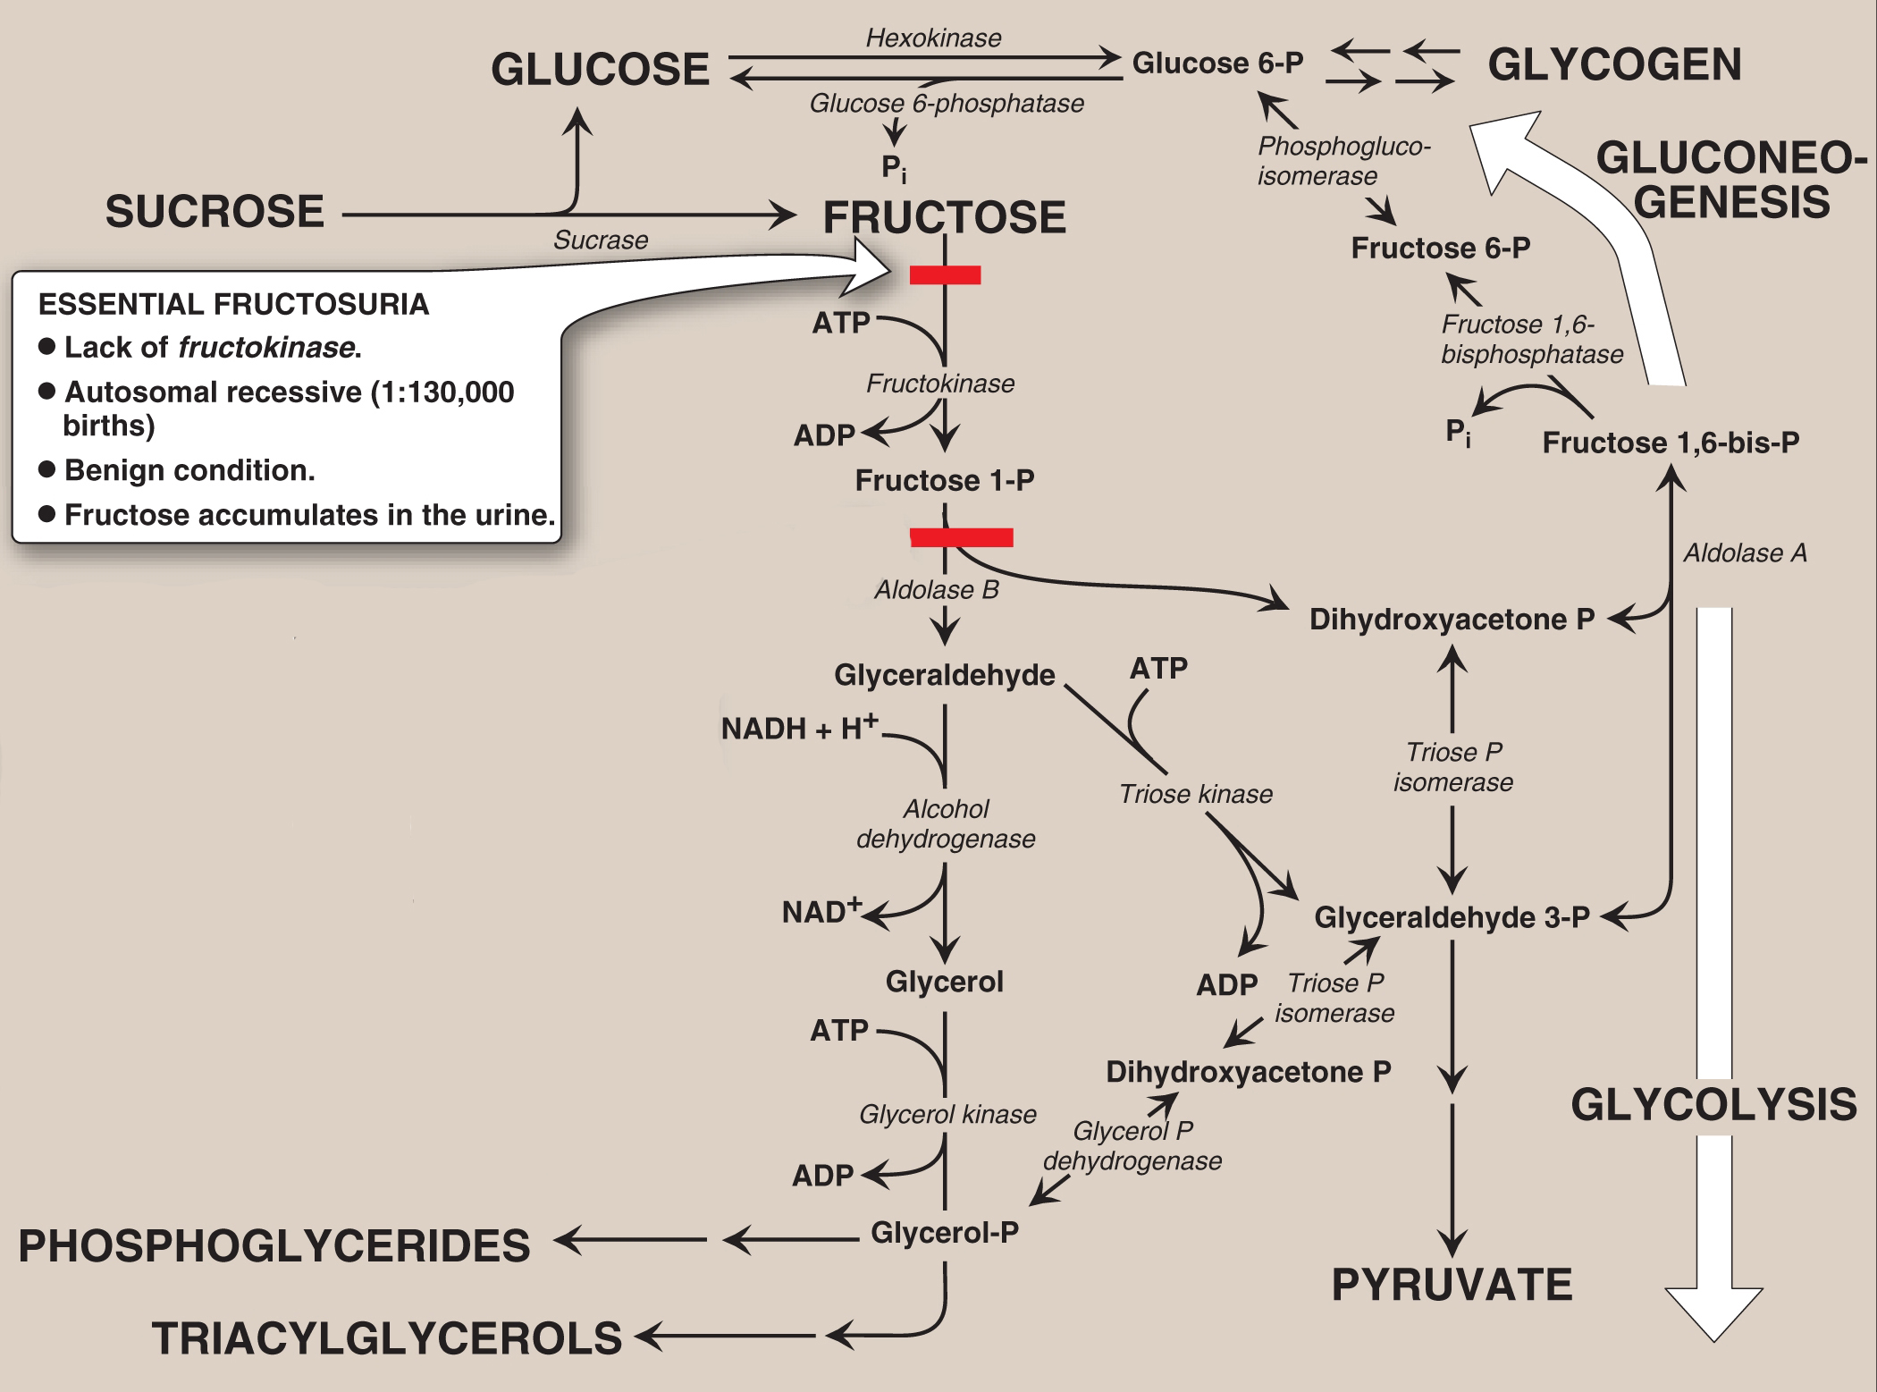

Slide 12
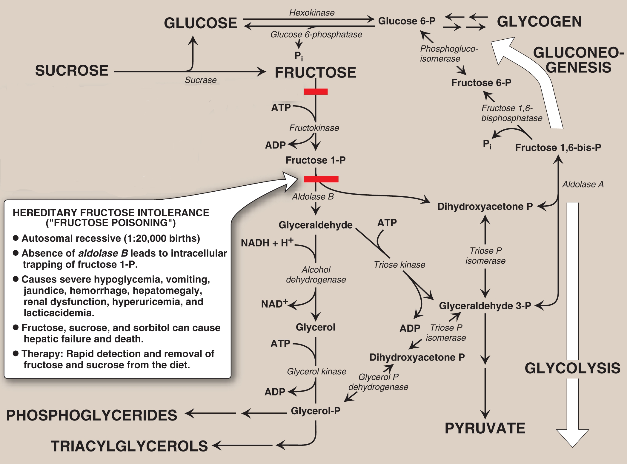

Slide 14
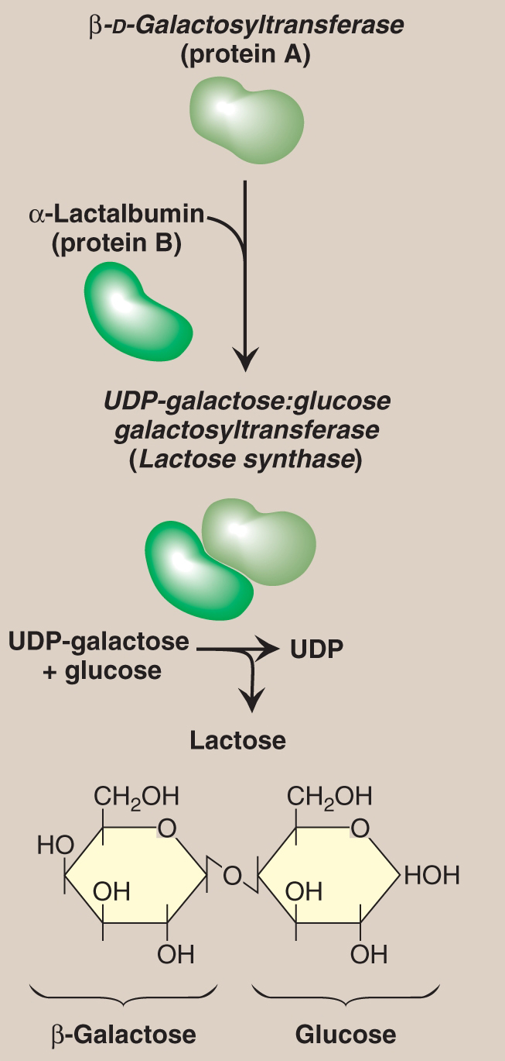
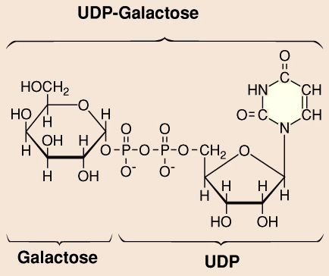
Lactose Synthesis
Stimulated by prolactin
Occurs in ER and Golgi bodies of human mammary glands
Lactose synthase

Slide 15
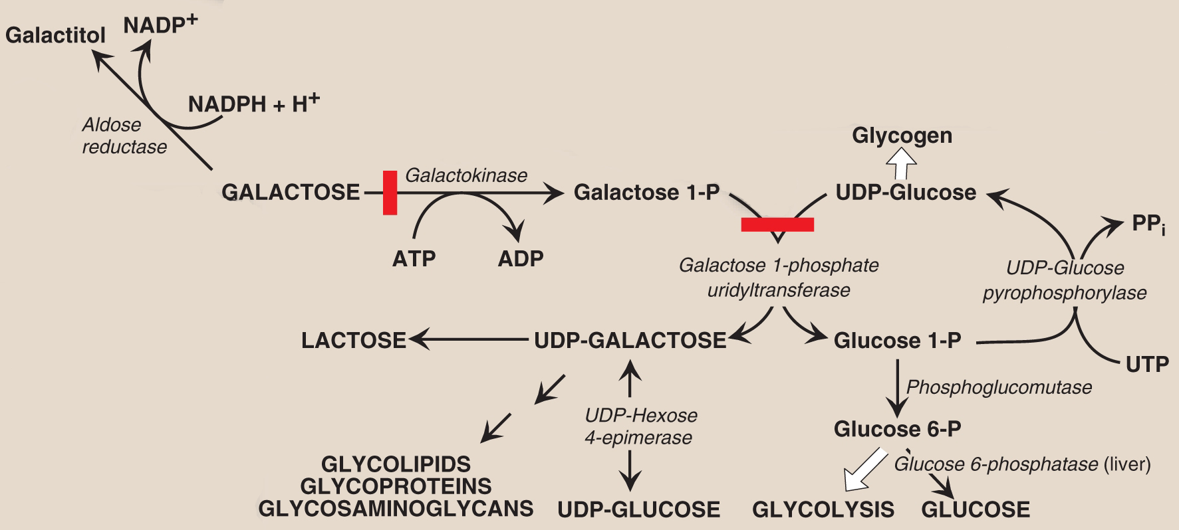
Galactose metabolism

Slide 16
Galactose metabolism

Slide 17
Galactose metabolic disorders
Classic galactosemia
Uridyltransferase deficiency
Autosomal recessive disorder (1 in 23,000 births)

